Slide 1

Technology for Social Good: Promises and Potentials
Harshvardhan J. Pandit
PhD Researcher, Theme E, TCD
harshvardhan.pandit@adaptcentre.ie | @coolharsh55

Slide 2
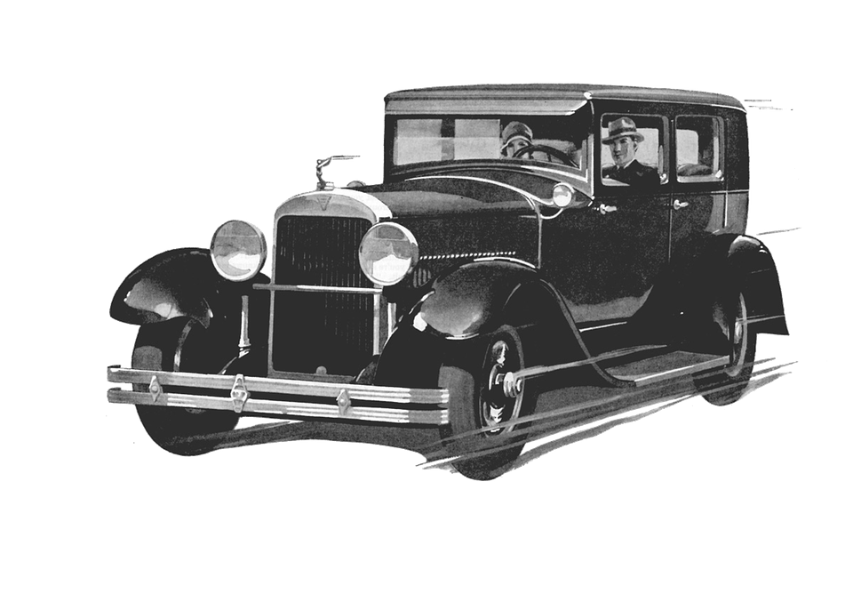
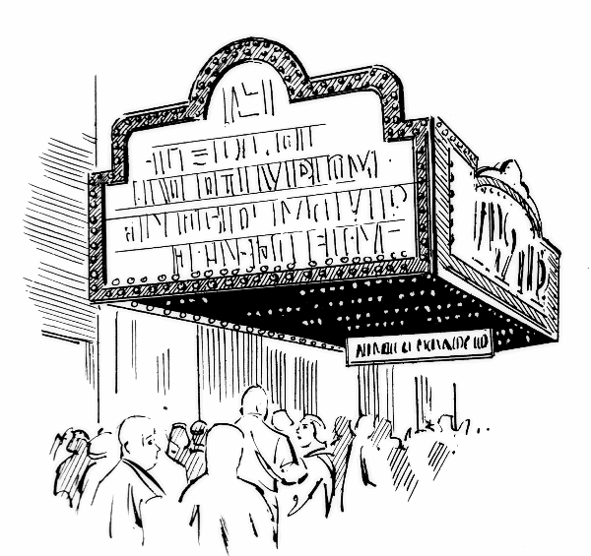


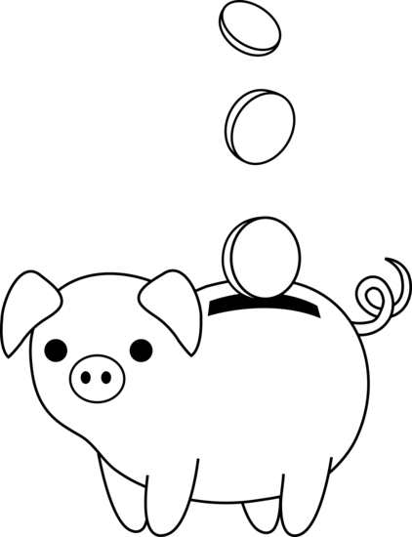
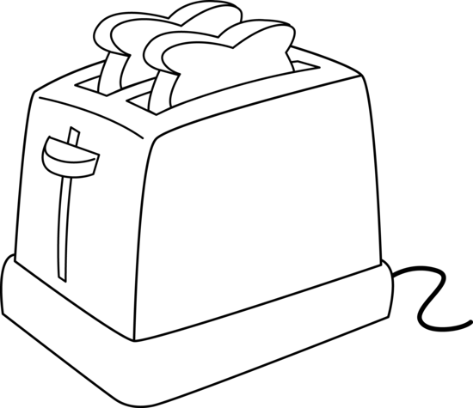
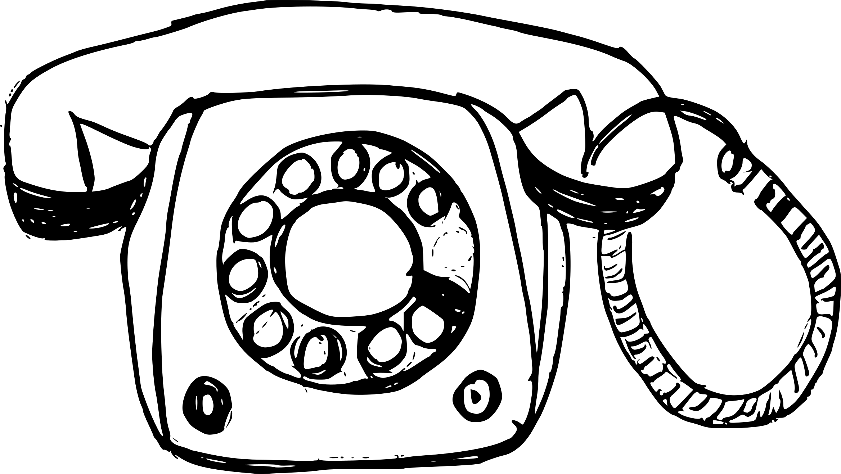
What is Technology?
“practical application of knowledge”
transport
entertainment
health / medicine
energy
food
finance
communication
<number>

Slide 3
Technology is anything invented after you were born, everything else is just stuff
Alan Kay
Human-Computer Interface pioneer
<number>

Slide 4
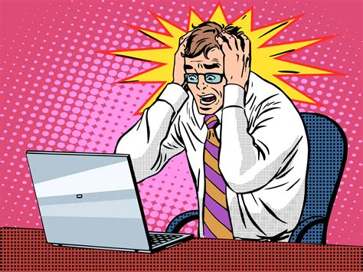
Common ‘problems’ discussed in relation to technology
Privacy!
Surveillance!
Morality! Ethics!
Safety!
Security!
Terrorism!
Compensation! Copyright!
Dependance!
<number>

Slide 5
Can we re-apply lessons learned in developing one area of technology to another?
A Social Theorem
<number>

Slide 6
The cycle of technology vs social good
Promises
Efficiency
Reliability
Automation
Convenience
Scale
Resource Utilisation
Pitfalls
Safety
Security
Accountability
Privilege
Trust
Social Impact
<number>

Slide 7
Technology is a useful servant but a dangerous master
Christian Lous Lange
historian, political scientist, 1869-1938
<number>

Slide 8


We have always been learning...
We start with benefits and then add safety measures...
<number>

Slide 9
Social interaction with Technology
Laws / Regulations e.g. safe limits of radiation in phones
Engineered features e.g. auto-shutoff when phones get hot
Social Demand e.g. transparent reports, independent verification
<number>

Slide 10
We believe everyone should do the ‘right thing’, but disagree on what is right
Why Good People Do Bad Things: Understanding Our Darker Selves - James Hollis
<number>

Slide 11
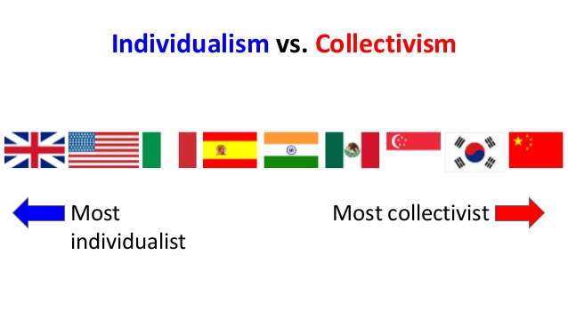
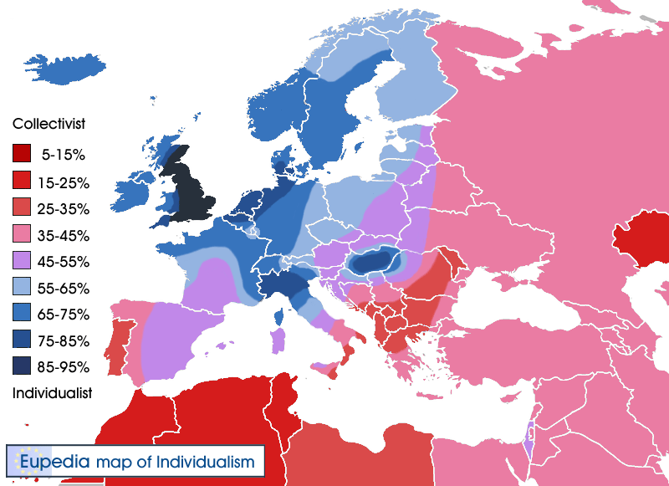
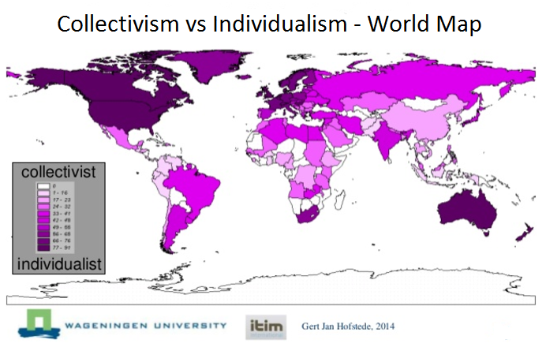
Morals and Ethical Values change across culture
Hofstede's cultural dimensions theory
<number>

Slide 12
Debating in silos...
Benefit ← the hidden agenda
Who will not benefit?
Is it disproportionate?
Accountability ← who to look for when things go wrong
Who will be responsible?
Can there be a vaccum of responsibility?
Legality ← how to enshrine a social agreement
Should something immoral also be illegal?
What should be the punishment for deviating from the law?
<number>

Slide 13
Technology for Social Good -
Promises and Potentials
Harshvardhan J. Pandit
<number>

